Slide 1
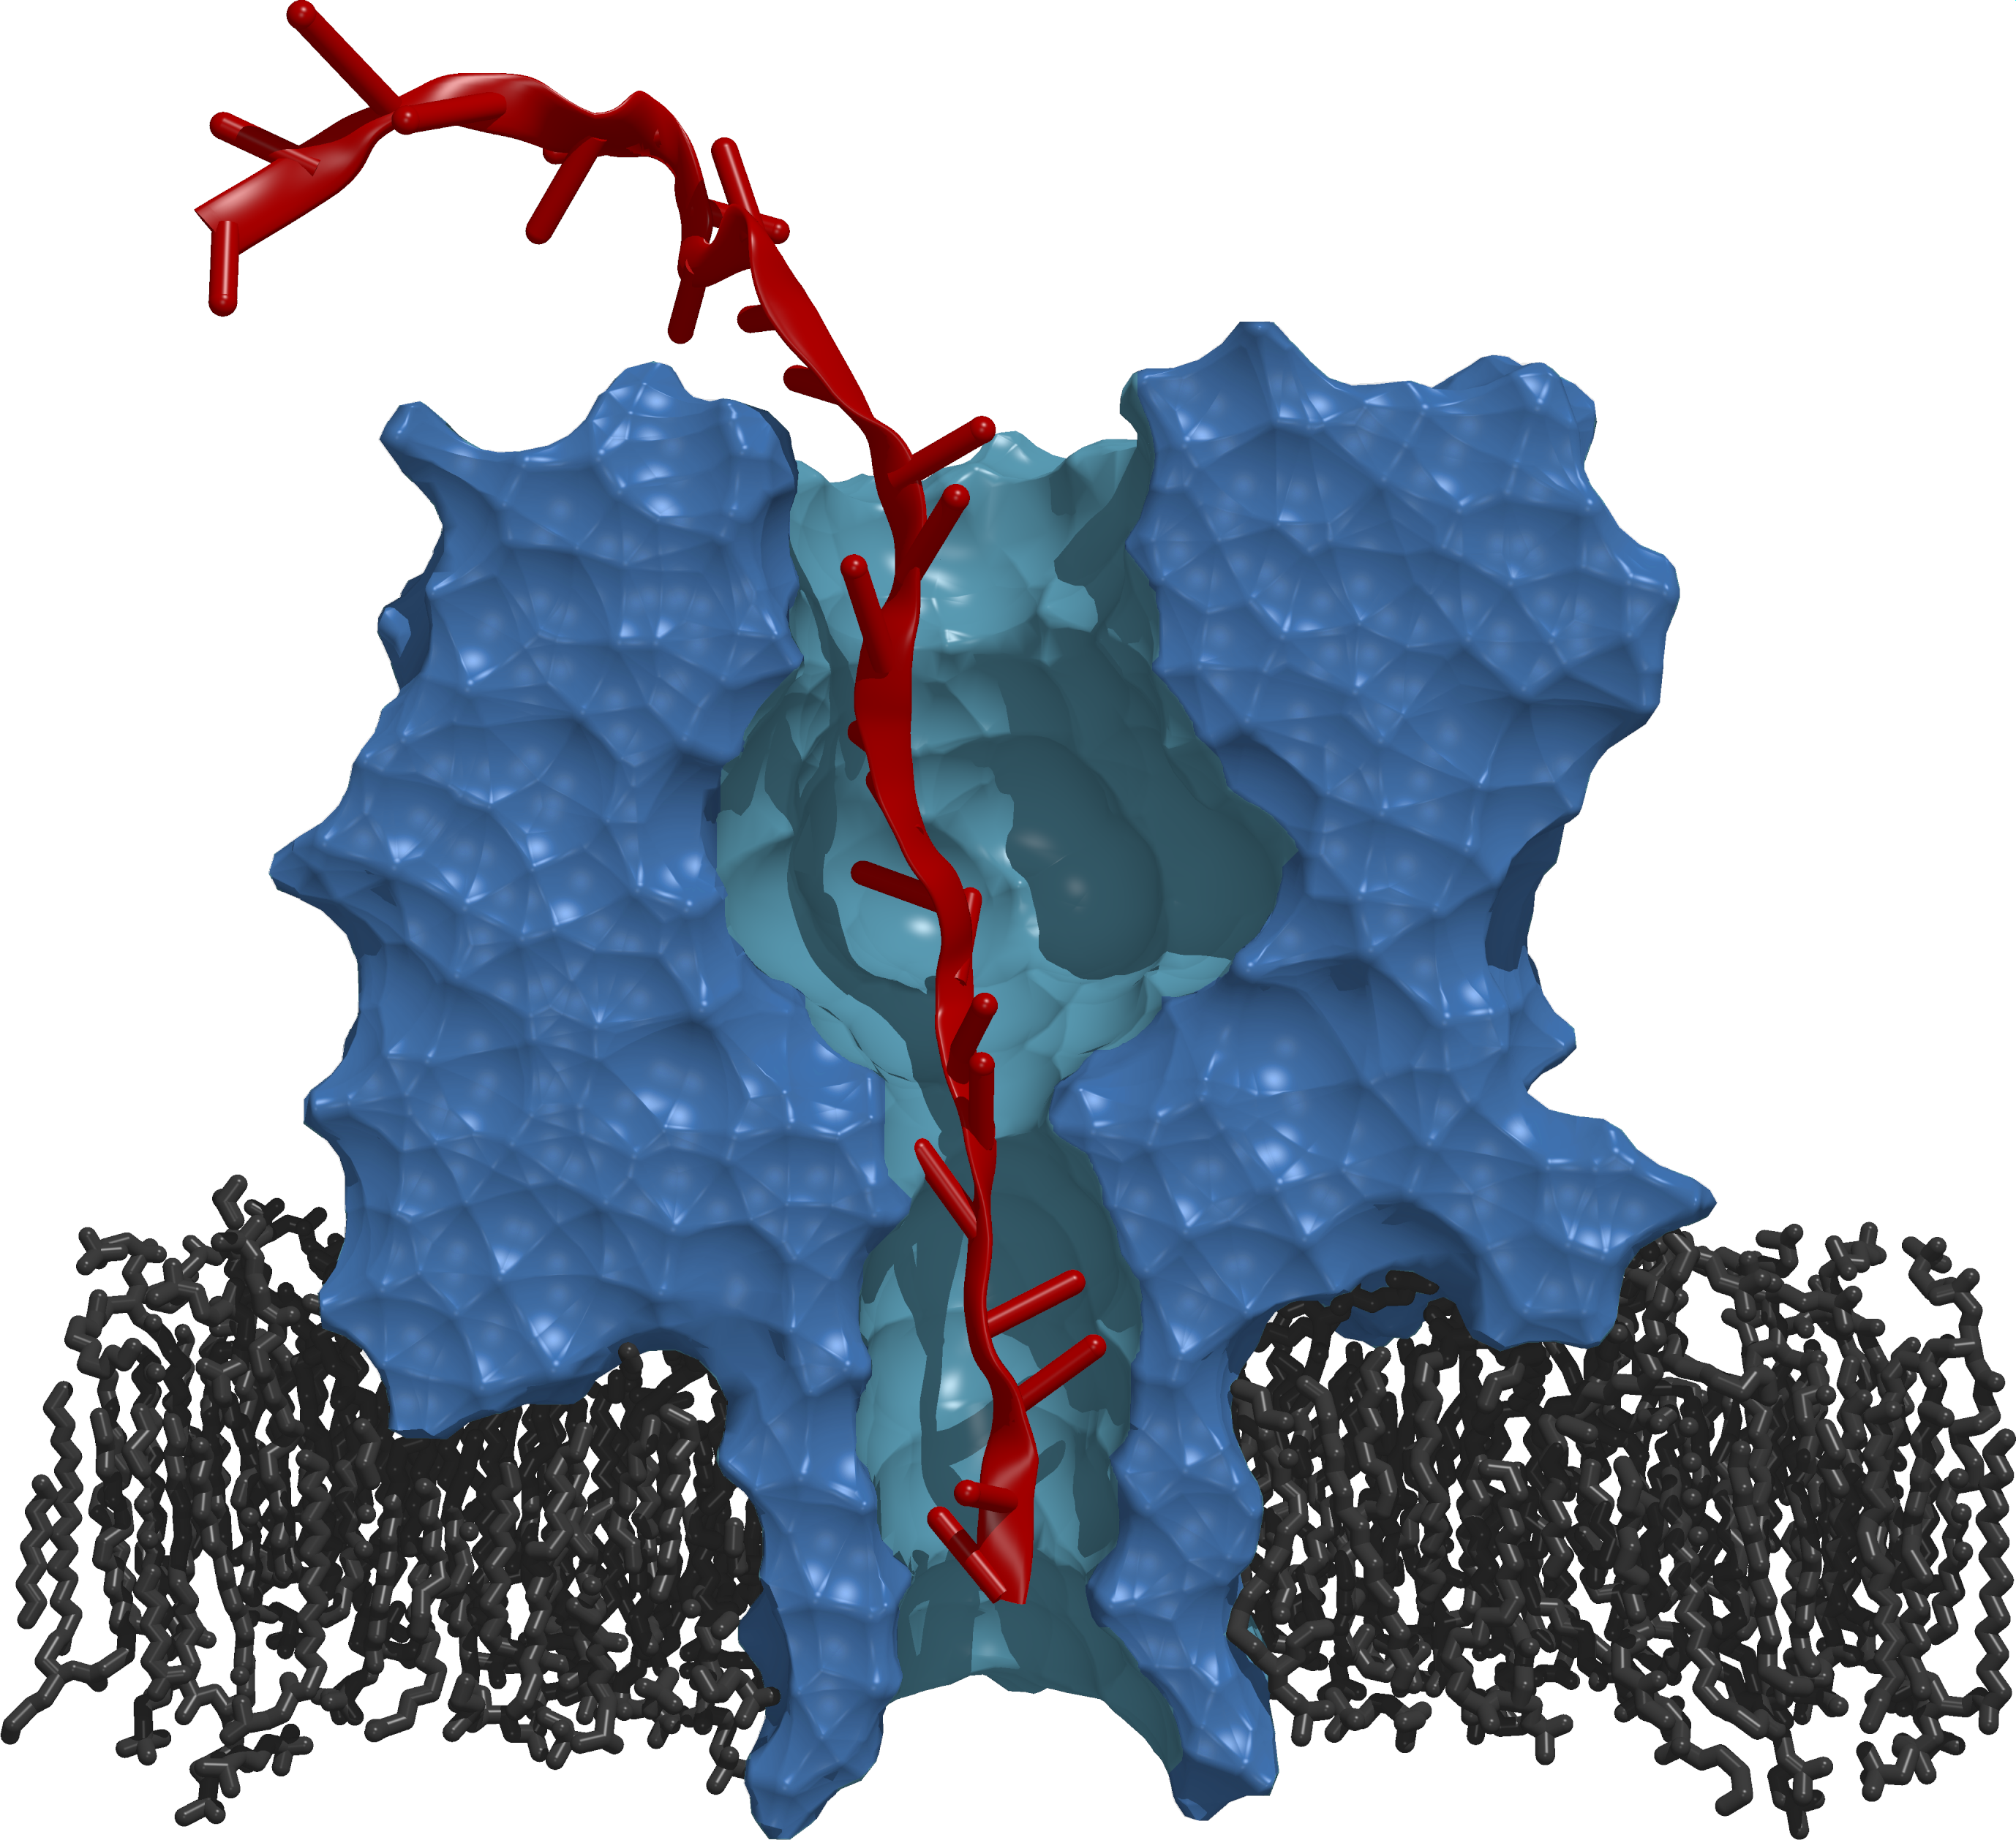

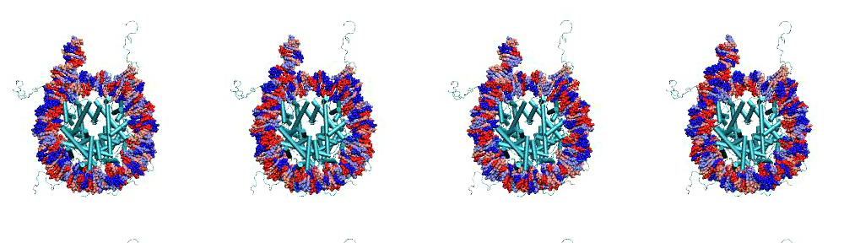
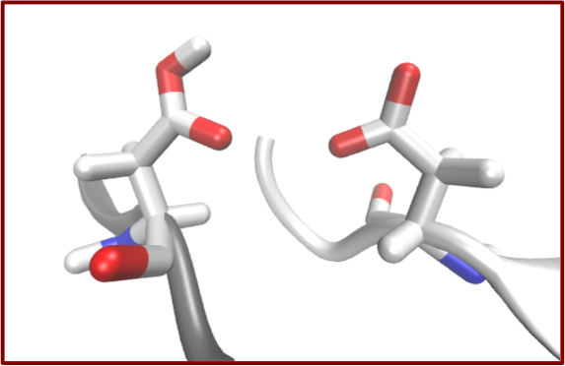
Abstractions, Models and Implementations for Scalable Approaches to Many Simulations
Shantenu Jha
http://radical.rutgers.edu

Slide 2
Outline
Understanding “Many Simulations”
Common many simulations scenarios, towards complex applications
Distributed Extreme-Scale Computing (DEC)
Challenges and Requirements for many simulations scenarios
RADICAL models and tools for many-simulation applications
The present: P*, BigJob and SAGA-python and how they are used to support ensembles and replica-exchange applications.
Future Work: Next Generation Middleware (NGMW)
Many aspects and considerations, but focus on many simulations
Notes:
This is different from why distributed exascale computing
PF = PetaFlops
Free-energy = measure of the degree of dynamism of a physical system
Enhance sampling = we cannot sample every state, we use algorithms to reduce the number of sampled state, still effective because of ergodic hypothesis.
Simulation:
Homogeneous/heterogeneous = the same physical system simulated with different parameters / different physical systems
Coordination = Temporal and special ordering (leads to different models of communication?)
Dependences = Temporal among simulations.
Varying across these axes you can generate almost any workflow.
Bag of tasks is the center.

Slide 3
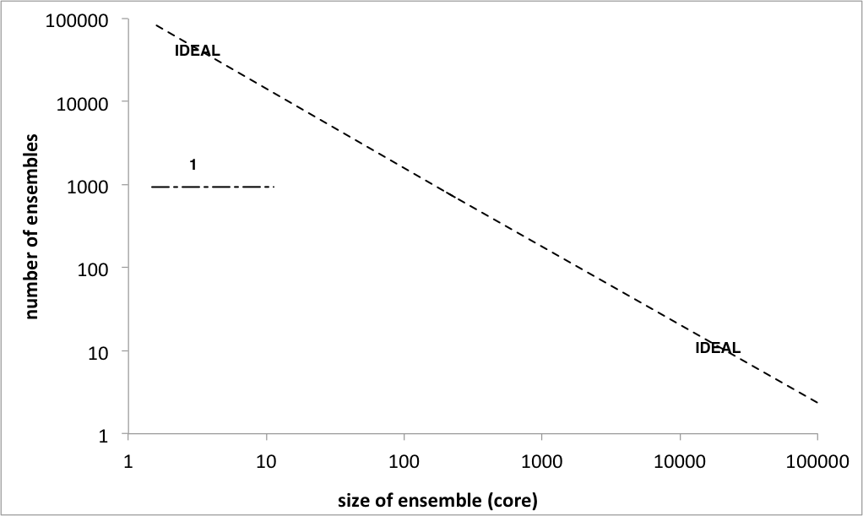
“Many Simulations” Pathway to Extreme Scale
Problems in computational science naturally amenable to “many simulations” model of computing:
Many free energy calculations, enhanced sampling problems.
Many multi-physics simulations are also multi components.
Single “application” might be broken into many smaller simulations
This is not just HTC or HPC, but complex application objectives
Isn’t about just peak perf, nor maximal throughput
Given access to X cores/nodes – slice/dice or distribute as needed
Notes:
PF = PetaFlops
Free-energy = measure of the degree of dynamism of a physical system.
Enhance sampling = we cannot sample every state, we use algorithms to reduce the number of sampled states, still effective because of ergodic hypothesis.
Simulation:
Homogeneous/heterogeneous = the same physical system simulated with different parameters / different physical systems
Coordination = Temporal and special ordering (leads to different models of communication?)
Dependences = Temporal among simulations.
Varying across these axes you can generate almost any workflow.
Bag of tasks is the center.

Slide 4
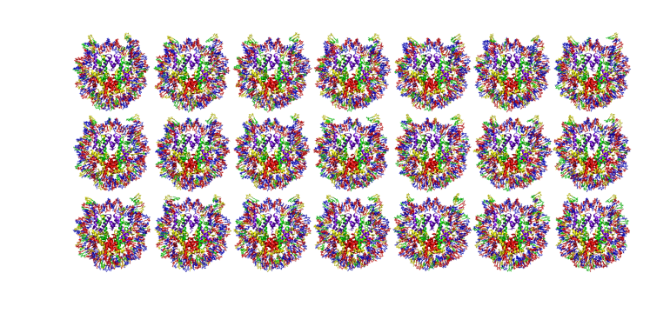
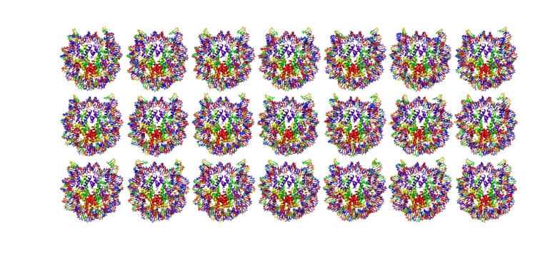
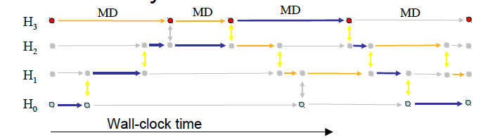
Scalable Online Comparative Genomics of Mononucleosomes.
“Scalable Online Comparative Genomics of Mononucleosomes: A BigJob” , Proceedings of Conference on XSEDE, 2013.
Asynchronous Replica-Exchange: Advanced Algorithms for enhanced sampling.
“A Framework for Flexible and Scalable Replica-Exchange on Production Distributed CI”, Proceedings of Conference on XSEDE, 2013.
Notes:
Set up the problem of synchronizing many tasks! Get histogram
Many simulation
A simulation is a single MPI job
They are all MPI – 128 – 512 cores for each simulation
Problem 1: determine the binding and position of the mononucleosome – Enemble:
210 combinations, 20 nanoseconds, repeats 10 times to get 20 nanoseconds, 2100 simulations for 1 particular study (candidate). The problem is not reducible and hits the limits of computational availability (e.g. cluster available with queues of 24h)
240 cores/hour, 3.5GB output per 1ns simulation.
Group of tasks have temporal dependencies but the tasks themselves are independent (bag of tasks)
Problem 2: Molecular simulation – Replica exchange:
Running multiple replicas at the same time (anything from few to hundreds of thousands, the more the merrier because better approximation to the problem)
Tasks needs to synchronize by means of communication. Different algorithms to do that, pairing pre-defined => regular replica exchange. Replicas are exchanging anyway. Pairing and time of exchange can be fixed (regular) or dynamic (irregular).
For both cases: the more the better for the science.
The class of scientific problems that is amenable to ‘Many Simulations’ approach is called: free energy.

Slide 5
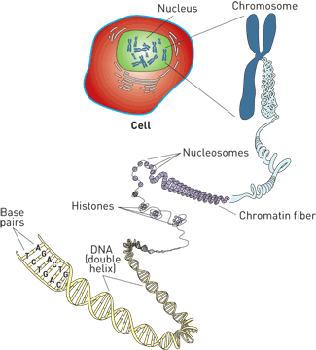
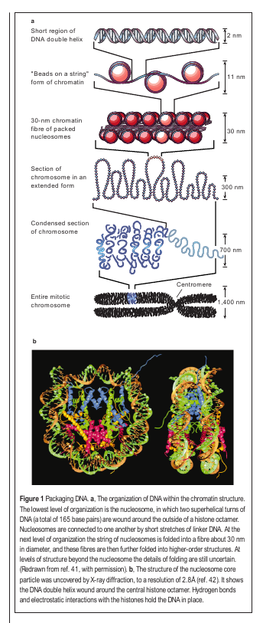
Setting the Scale
A Typical “Run”
210 Simulations (5 x 21 x 2)
2400 Cores on Lonestar for ~21 hrs
~50,000 SUs
~750 GB of output
Total:
10+ Runs (2100 simulations)
4 Restarts
~500,000+ SUs
~7.5 TB of output
Felsenfeld&Groudine,
Nature Jan 2003

Slide 6
From Many Simulations to Complex Applications
Starting from uncoupled heterogeneous simulations, varying levels of coordination and dependency can be gradually added and “tuned”
Homogeneous/Heterogeneous
Complexity of simulation-resources mapping
Coupling between simulations
Different coordination mechanism
Dependencies
Constraints, scheduling, data transfer
D
C
H
Depending upon the above properties, the importance and feasibility of distribution varies
Notes:
PF = PetaFlops
Free-energy = measure of the degree of dynamism of a physical system.
Enhance sampling = we cannot sample every state, we use algorithms to reduce the number of sampled states, still effective because of ergodic hypothesis.
Simulation:
Homogeneous/heterogeneous = the same physical system simulated with different parameters / different physical systems
Coordination = Temporal and special ordering (leads to different models of communication?)
Dependences = Temporal among simulations.
Varying across these axes you can generate almost any workflow.
Bag of tasks is the center.

Slide 7
Why Distributed Extreme Scale Computing?
Support new science and new usage modes
Different modes of extreme-scale computing
Coupling X-flops of computing with X-bytes of data
Large-scale simulations integrated with distributed big-data analysis (ATLAS, HEP)
Real-time computing coupled with distributed data from scientific experiments (LSST, SKA)
Support the “long tail of science”
New execution modes for efficient and effective utilization of collective set of resources
Offload workloads from leadership to less powerful machines
Onload workloads from distributed systems onto leadership
Strategically and synergistically, not competitively
Notes:
MORE THAN HPC/HTC
Nuanced view of Resources and application types!

Slide 8

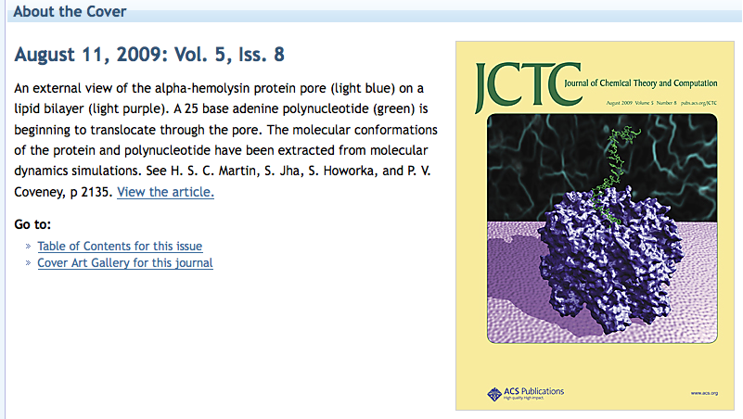
A Pore Man’s View of the TeraGrid/XSEDE
2005-09: Tried running many simulations on many supercomputers. Did not work (well)!
Why? What has changed?
Notes:
We are not speaking about a trivial problem! Formulating a problem in terms of many-simulations (partially) failed already at petascale:
A lot of the time has been spent in formulating the problem in terms of many simulations.
Marshaling/managing/efficient mapping happened at order 10, barely made order 100, broke down at order 1000 (of large simulations)
This problem highlights some of the challenges in running many simulations on many supercomputers
Things are not working. I contend that if we took a more systems approach to building our infrastructure -- viewed as a whole, expose/provide the right abstractions, then it is possible.

Slide 9
Extreme Scale Distributed Computing in 2013
First generation of DC characterized by “gluing it” together
Many local solutions, lack of end-to-end solutions
Inability to reason about spatio-temporal execution properties
Given a general workload there is an inability to estimate how long a workload will take? And where (and why) it will execute?
Complete absence of analytical models of applications, infrastructure
And we do not know how wrong our estimates would be!
We are still learning how to architect large-scale systems
Scaling remains difficult for individual scientists
< 1% can do O(100) tasks of O(10GB) over O(10) nodes
Macroscopic vs microscopic theory of distributed systems!
Missing principles and practice of “systems in the large”

Slide 10
DEC in Relation to “Traditional” EC
Many applications as opposed to a set of kernels that need to optimized
Metrics of performance varied, i.e. not just peak performance
Capture different modes of extreme-scale computing:
Couple X-flops with X-byte: both simulation and analysis.
Integrate multiple large-scale resources as an aggregated capability.
Design to support extreme scale collectively for many scalable applications
Community (HEP) applications, essentially similar
Application structure simple, but infrastructural requirements difficult
Task-level composition and coordination is important and varied
External data infrastructure, repositories
Important role for middleware, explains why DEC SW environment is complex
Middleware: Platform to build common and integrated services, whilst hiding heterogeneous software & system access layers

Slide 11
DEC Some Common Requirements
Many requirements, but focus on two common and critical requirements
R1: Adaptive Application Formulation
Adaptive application formulation arising from non-deterministic application behavior requires flexible composition and extensible capabilities
Non-deterministic application behaviour (e.g., resource requirement)
R2: Dynamic Resource Utilization
Growing/shinking resource pool
Need abstractions that:
A1: Decouple workload and resource management
A2: Provide these capabilities in an extensible and interoperable way
Need to provide these abstractions as well engineered tools
Employ CI best practices and software sustainability
Notes:
How we have used open source, standard-based API to construct powerful tools.
Dynamic Resource Management: A plus (+)
sour

Slide 12
RADICAL Abstractions, Models and Tools

Slide 13
Pilot Abstractions
Working definition: A system that generalizes a placeholder job to provide multi-level scheduling to allow application-level control over the system scheduler via a scheduling overlay.
User Space
User Application
Pilot-Job System
Policies
Pilot-Job
Pilot-Job
Resource Manager
System Space
Resource A
Resource B
Resource C
Resource D

Slide 14
Introduction to Pilot-Abstraction (2)
Working definitions:
A system that generalizes a placeholder job to provide multi-level scheduling to allow application-level control over the system scheduler via a scheduling overlay
“.. defined as an abstraction that generalizes the reoccurring concept of utilizing a placeholder job as a container for a set of compute tasks; an instance of that placeholder job is referred to as Pilot-Job or pilot.”
Advantages of Pilot-Abstractions:
The Perfect Pilot: Decouples workload from resource management
Flexible Resource Management
Enables the fine-grained (ie “slicing and dicing”) of resources
Tighter temporal control and other advantages of application-level Scheduling (avoid limitations of system-level only scheduling)
Move control, extensibility and flexibility “upwards”
Build higher-level capabilities without explicit resource management
Notes:
Pilot-jobs as a (A)RM because of limitations of the middleware and infrastructure. Different middleware; differenent limitations. Therefore different pilot jobs semantically and functionally.
Pilots tell you what to do (N x M) but not why or how?

Slide 15
Landscape of Pilot-Job Systems
There are many PJS offerings, often semantically distinct
PanDA, DIANE, DIRAC, Condor Glide-In, SWIFT, ToPoS Falkon, BigJob…
Why do you think there has been a proliferation of PJs?
Conceptual & practical barriers to extensibility (& interoperability)
The landscape of PJS reflects, in addition to PJS specifics, the broader eco-system of distributed middleware & infrastructure
Software Engineering issues, interfaces, standardization
Difference in the execution models of the PJ
We know “what” pilot-jobs do, but the “how” remains less clear
How to map tasks to pilot-jobs? How to choose/map optimal resource?
How to “slice and dice” resources?
Data remains a dependent variable, not a primary variable
Introduce the concept of Pilot-data
Notes:
Pilot-jobs as a (A)RM because of limitations of the middleware and infrastructure. Different middleware; differenent limitations. Therefore different pilot jobs semantically and functionally.
Pilots tell you what to do (N x M) but not why or how?

Slide 16
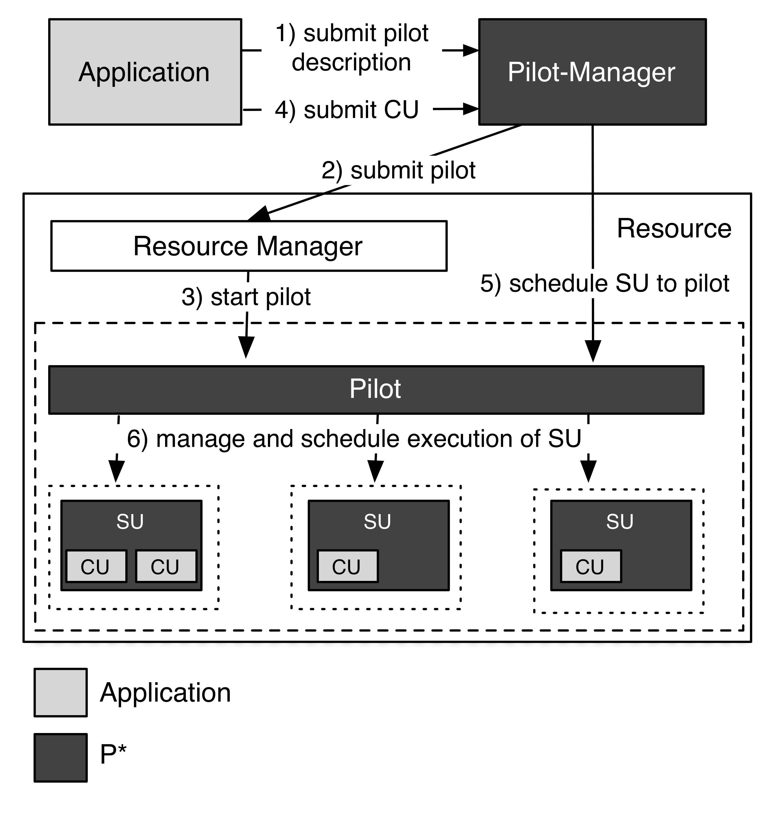
P* Model: Elements, Characteristics and API
Elements:
Pilot-Compute (PC).
Pilot-Data (PD).
Compute Unit (CU).
Data Unit (DU).
Scheduling Unit (SU).
Pilot-Manager (PM).
Characteristics:
Coordination.
Communication.
Scheduling.
Pilot-API.
“P*: A Model of Pilot-Abstractions”, 8th IEEE International Conference on e-Science 2012, 2012

Slide 17
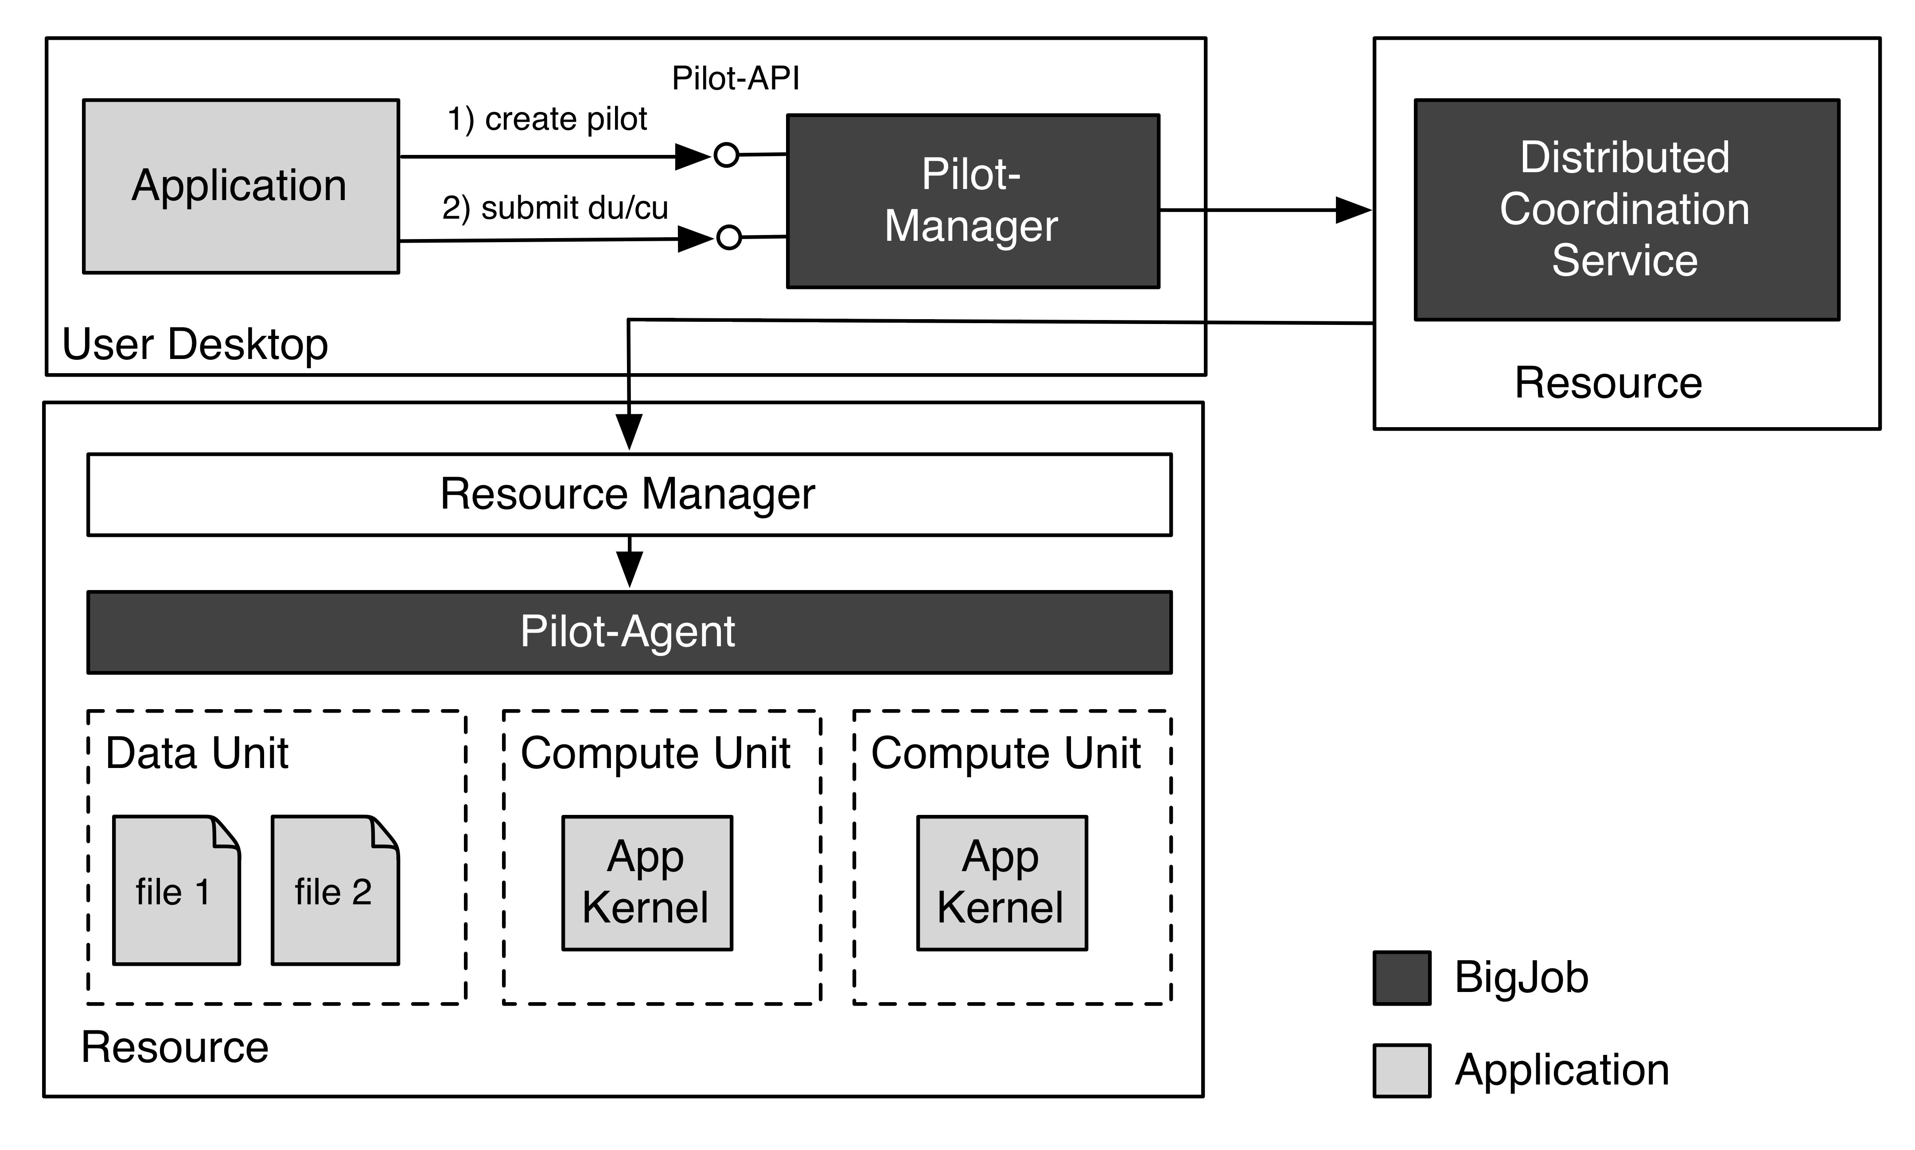
BigJob: Architecture

Slide 18
“Coarse-Grained” BigJob Performance
Number of zero-payload tasks that BJ can dispatch per second:
Distributed: O(1)
Locally: > O(10)
Number of Pilots (Pilot-Agents) that can be marshaled
Locally/Distributed: O(100)
Typical number of tasks per Pilot-Agent:
Locally/distributed: O(1000)
Number of tasks concurrently managed = Number of Pilot-Agents x tasks per each agent :
O(100) x O(1000)
(Obviously) The above depends upon data per task:
BigJob has been used over O(1)--O(10⁹) bytes/task, for tasks of duration O(1) second to O(10⁵) seconds

Slide 19
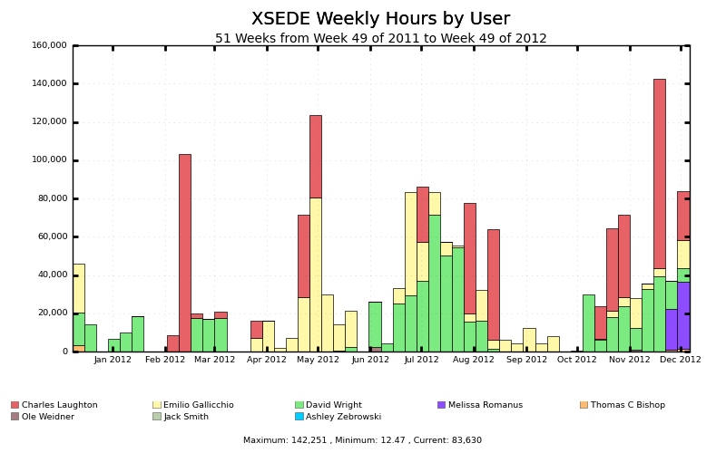
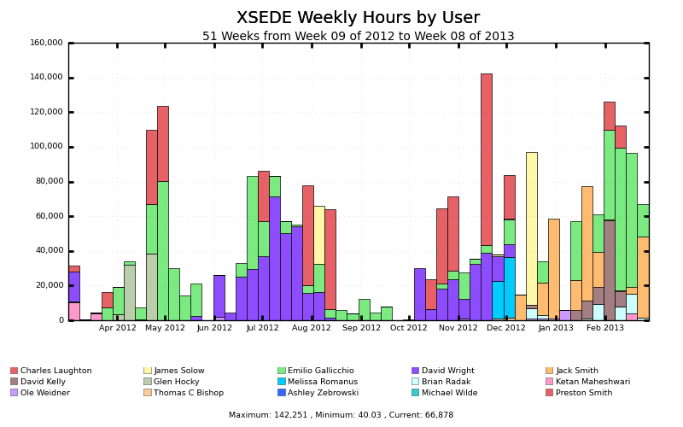
BigJob: (Partial) Usage on XSEDE Machines
> 10M SUs/year (and increasing) on XSEDE machines

Slide 20
SAGA: Interoperability Layer for BigJob
SAGA – Simple API for Distributed (“Grid”) Applications:
Application level standardized (Open Grid Forum GFD.90) API.
Application is a broad term: “one person’s application is another person’s tool (building block)”.
SAGA-Python:
Native Python implementation of Open Grid Forum GFD.90.
Allows access to different middleware / services through a unified interface
Provides access via different backend plug-ins (“adaptors”).
SAGA-Python provides both a common API, but also unified semantics across heterogeneous middleware:
Transparent Remote operations (SSH / GSISSH tunneling).
Asynchronous operations.
Callbacks.
Error Handling.

Slide 21
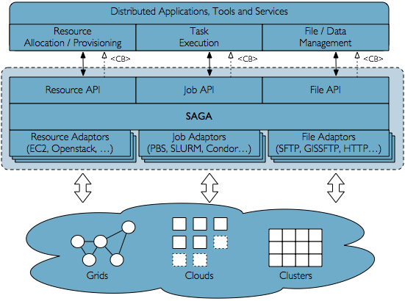
SAGA Schematic

Slide 22
SAGA: Interoperability layer upon which other tools and applications are built
HOW SAGA is Used?
Uniform Access-layer to DCI, e.g, EGI, XSEDE, etc
Application “Scripting Layer” to DCI
Build tools, middleware services and capabilities e.g. Gateways,
WHAT is SAGA Used for?
Production-grade science and engineering and research tool to design, implement and reason about distributed programming models, systems and applications
Where is SAGA Used?
Pilot-job and Workflow systems, science gateways and web portals
Domain-specific (distributed) applications, libraries and frameworks

Slide 23
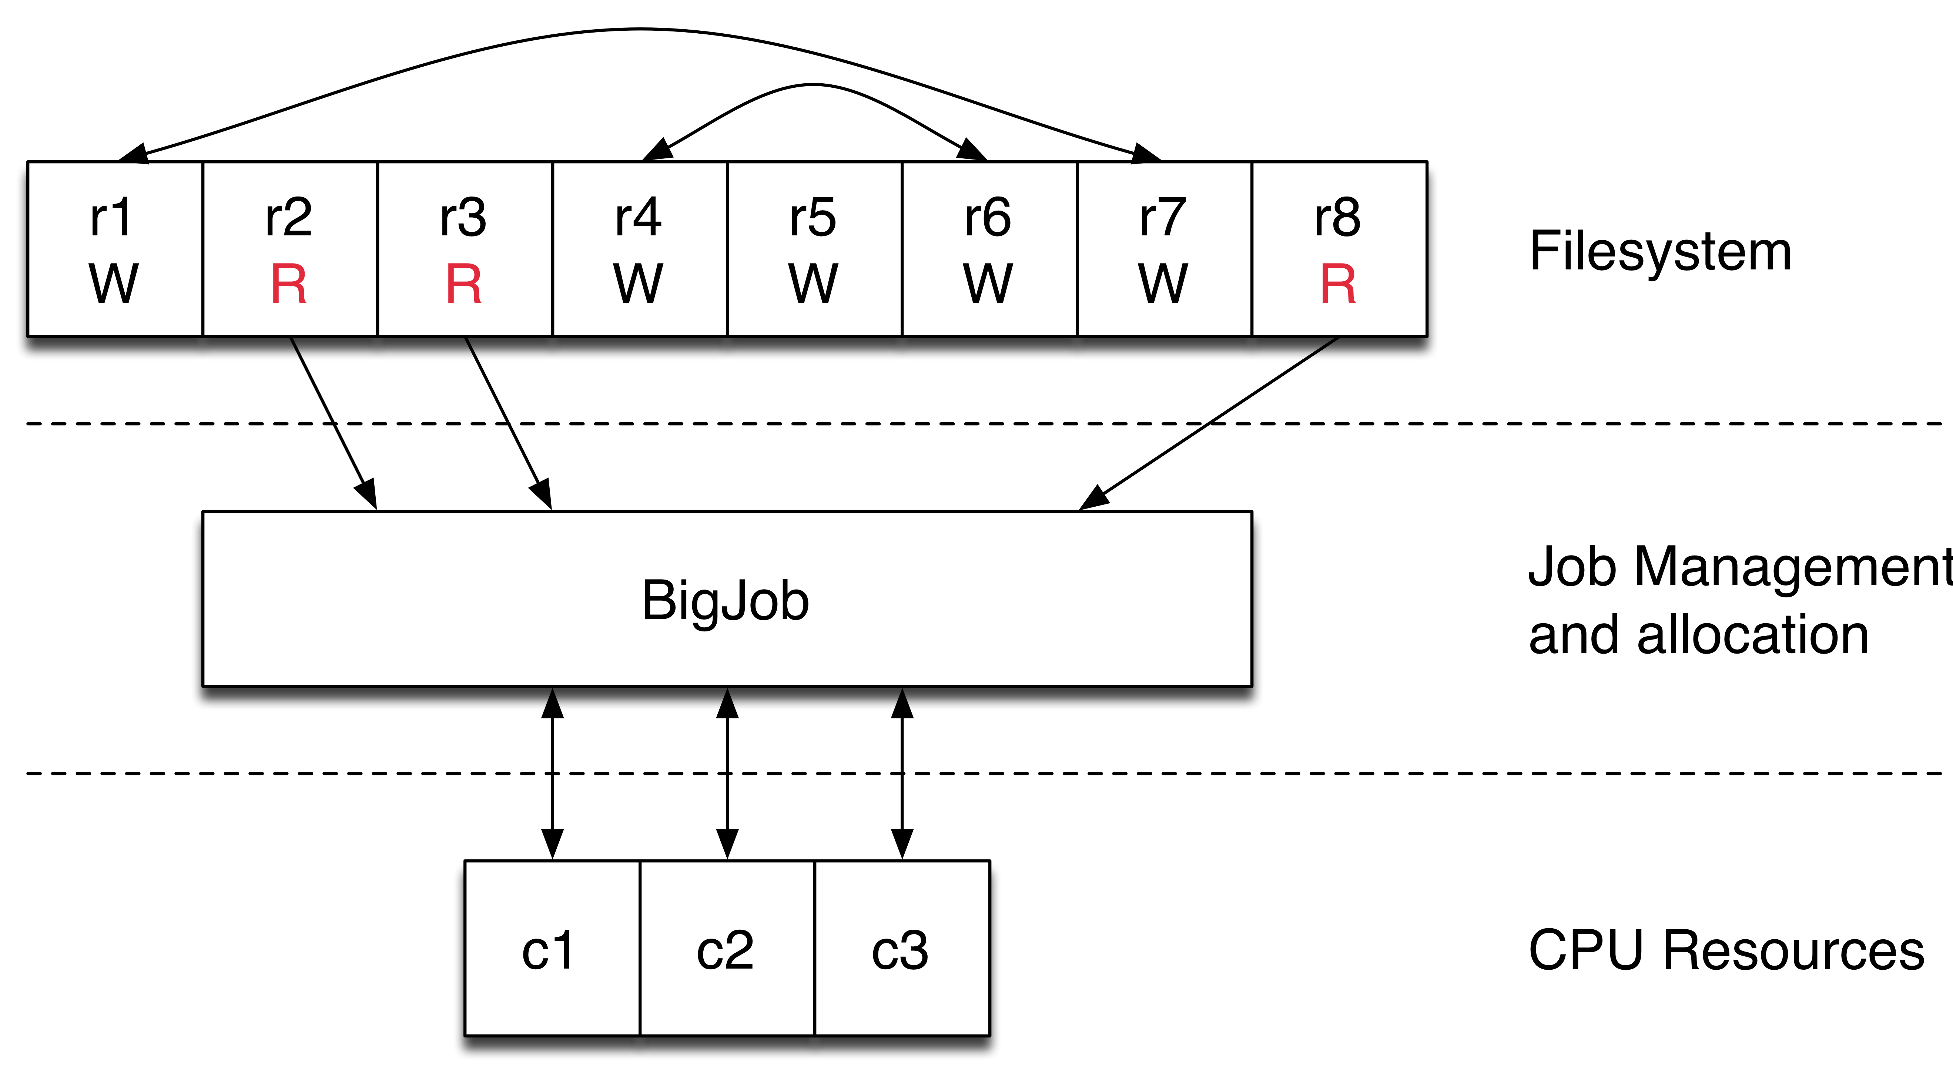
Async Replica-Exchange Library
Built to perform file-based asynchronous parallel replica exchange.
Platform independent library.
https://github.com/saga-project/asyncre-bigjob
Notes:
MD?

Slide 24
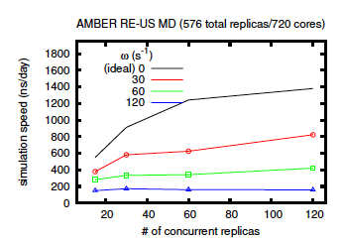
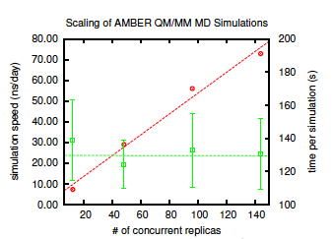
Async Replica-Exchange Library
Ideal performance considered to be zero coupling in this case.
Diminished results due to coordination overheads.
Scientists are free to choose the best tradeoff between simulation speed and number of concurrent replicas.
BigJob-based Repex: Amongst the earliest QM/MM.
Notes:
Rate of communication affect science but it is about the scientist to choose how optimize it. The same is valid of the number of simulation for micro second.
Doing something qualitatively new in quantum mechanical community (second diagram).
Do we have a publication for repex?

Slide 25
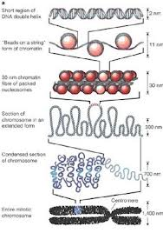
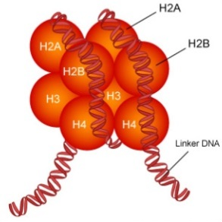
What is a Nucleosome?

Slide 26
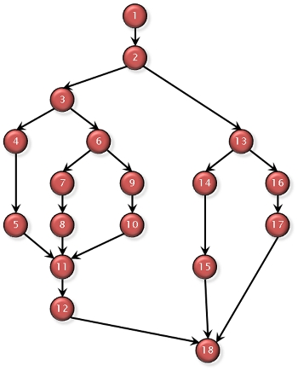
Computational Workflow
20ns simulation broken into chained sequence of 20 1ns simulations
Output of each required as input to next
Hierarchical directory structure
| -> Common Config files (one for each sequence)
| -> 5 nucleosome-free regions of chromosome
| - - Common Param files for each system
| - -> 21 threading position
| - - - 20 chained sequences
Data flow
COOR, VEL, XSC → COOR’, VEL’, XSC’ + DCD, DVD, XST, OUT, ERR
\ ___________/
Determining successful completion
“WallClock” at end of OUT, and no “FATAL”
Size of DCD

Slide 27
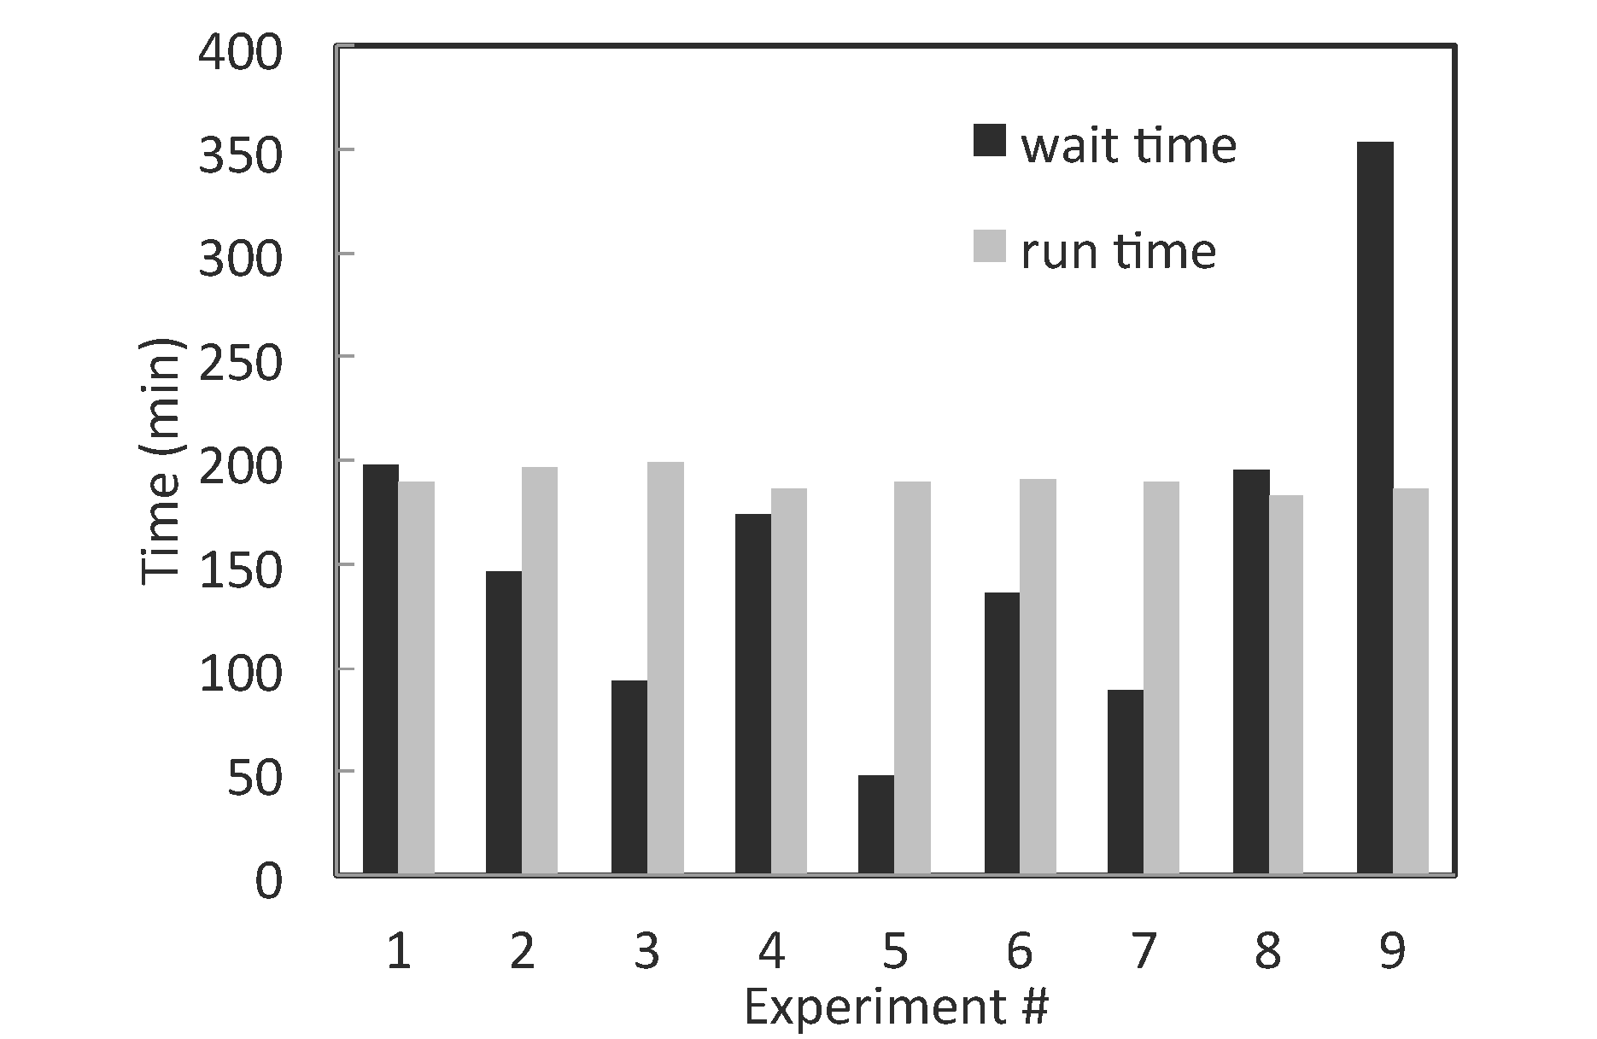
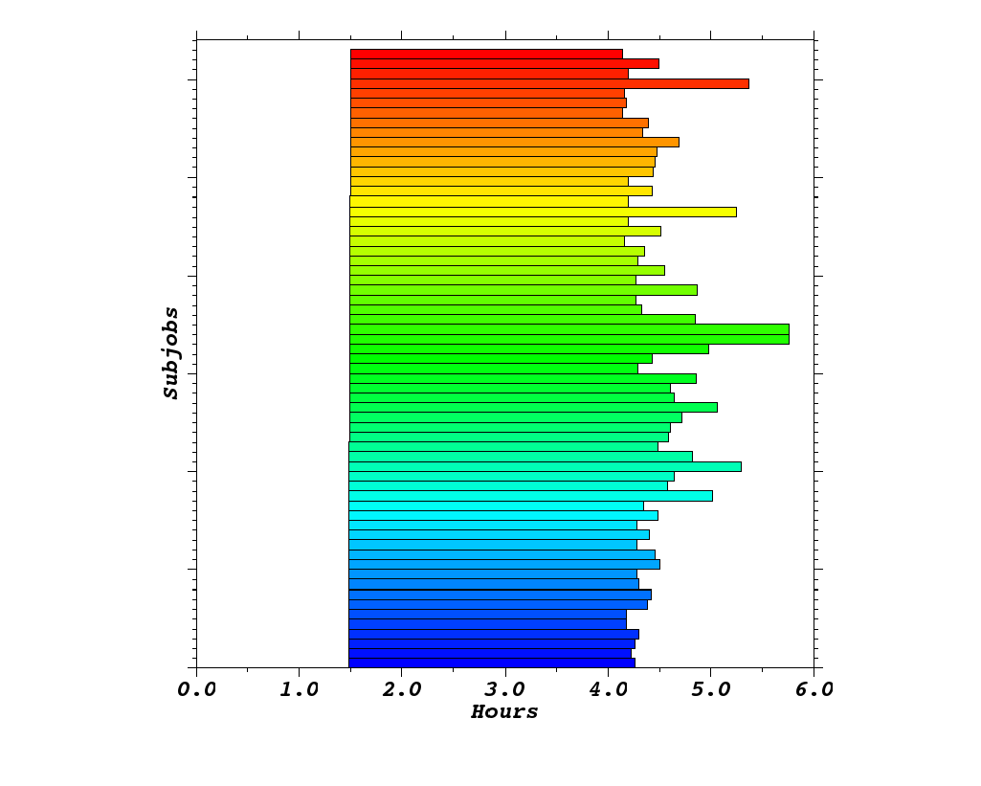
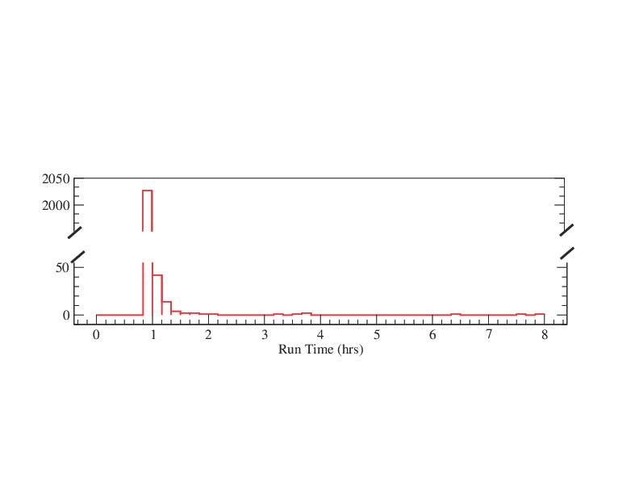
HT-HPC on Kraken 126 ensembles, each of 192 cores = 24192 cores

Slide 28
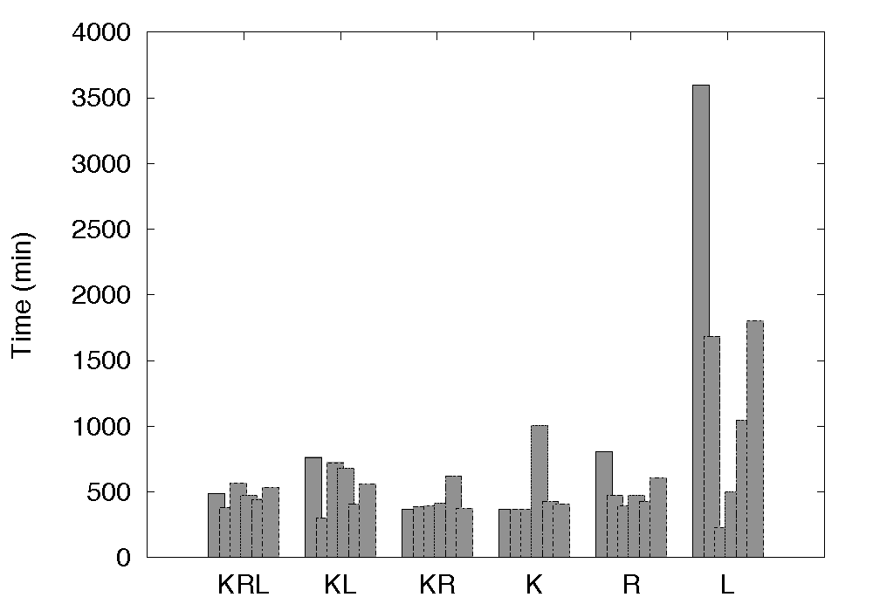
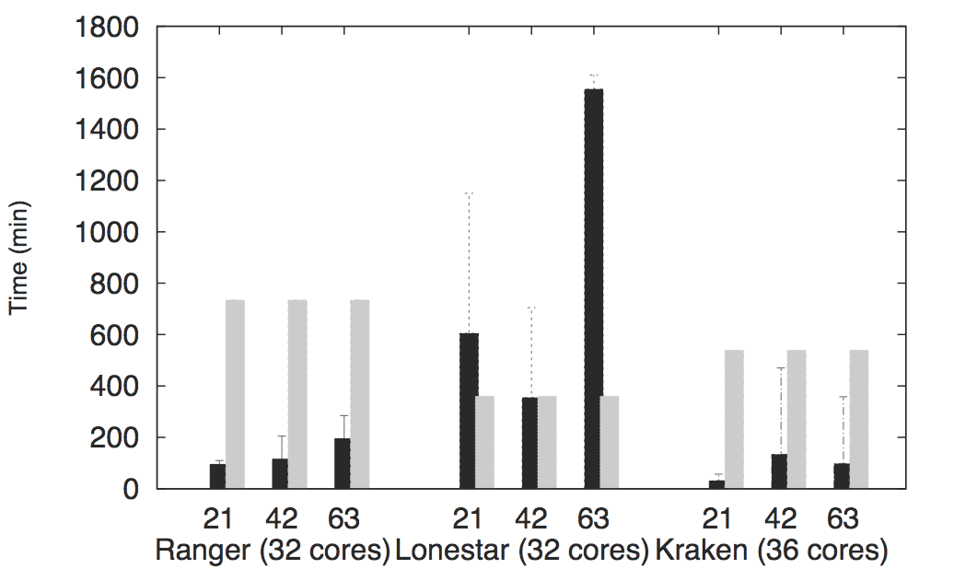
Scale-Out/Across
X-axis: number of tasks (size)

Slide 29
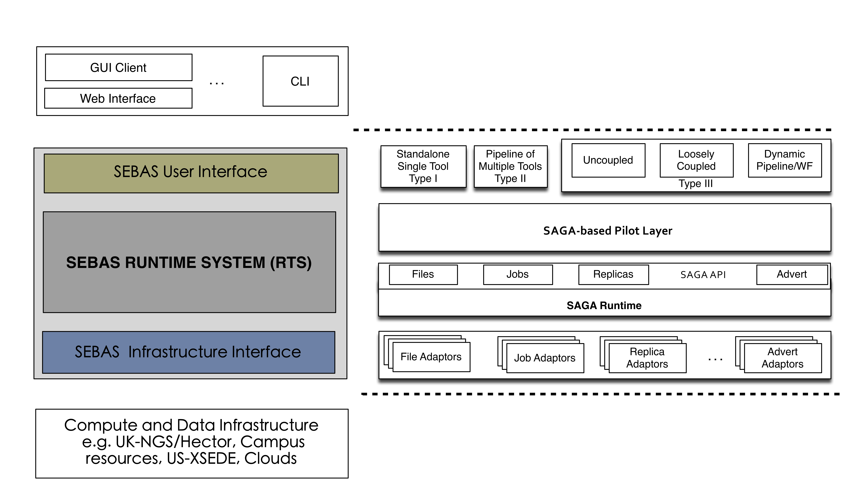
Scalable, Extensible HT Binding Energy Calculation
Platform independent library.
Suggestions for other libraries are welcome!
In consultation with Peter Coveney and Charlie Laughton.
Notes:
Mention EXTASI project: NSF + EPSRC.

Slide 30
Towards NGMW: A RADICAL Perspective

Slide 31
NGMW Functional Aims and Requirements
Functional Aims
“Beyond glue” to support spatio-temporal execution reasoning
What to distribute? Where/how to distribute? When to distribute?
Estimate time to completion?
Exposes well-defined capabilities rather than technology
Capability: Well-defined and aggregated functionality, without regard to how, or the specific approach used, e.g., num. of tasks, throughput, probabilistic bounds on time-to-completion
Functional Requirement
Support adaptive applications in conjunction with dynamic resources
Federate heterogeneous infrastructure to provide well-defined capabilities
Notes:
Integration of Information: Applications/Services/Tools about resources
Integrate information about applications and heterogeneous resources (compute, data and networks)
– Critical role for middleware

Slide 32
Towards NGMW for DEC
Workloads (W*)
Unified description: Workload representations from multiple applications are reduced into a minimal, common description.
Translation of the given workload into compute, data, and network units depending on the type and state of the available resources.
Overlays and Resources (F*, I*)
Formalization/Automation of the description, instantiation, and management of resource overlays for the given workload based on pilot abstractions.
Resource bundles: low-level resource aggregation.
Resource federation: high-level capabilities aggregation.
Workloads and overlays
Multiple algorithms available to schedule pilots onto resources and units onto pilots.
Decoupling between workloads and overlay utilization: Workflows, minimizing overlay overheads and maximizing overlay utilization.

Slide 33
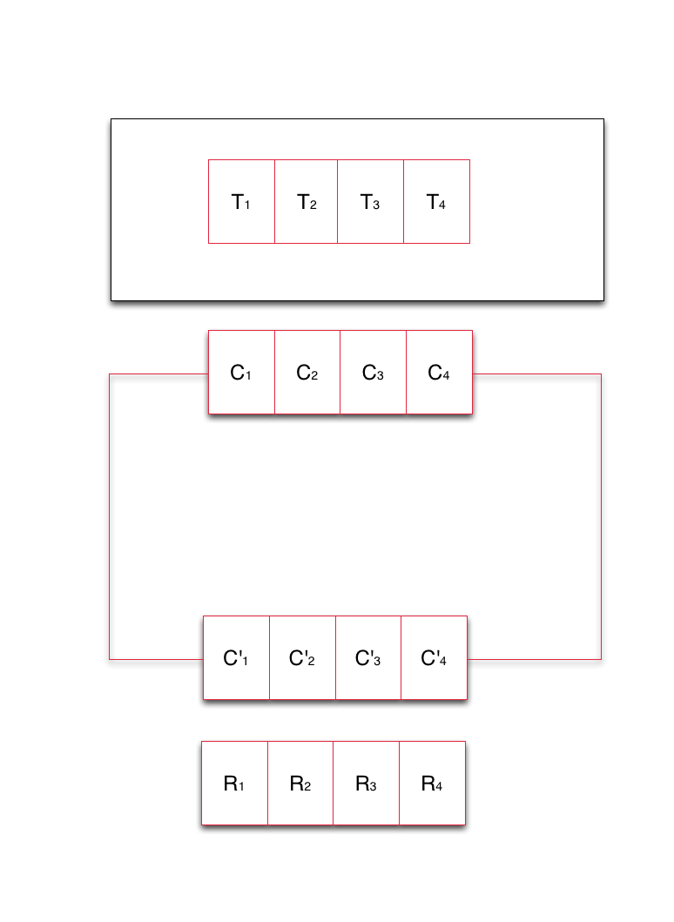
NGMW Schematic
Notes:
Middleware capabilities as an abstraction to resources
Middleware’s responsibility to support the set of capabilities that an application asks for and determine the collection of resources that can/must be used to provide capability

Slide 34
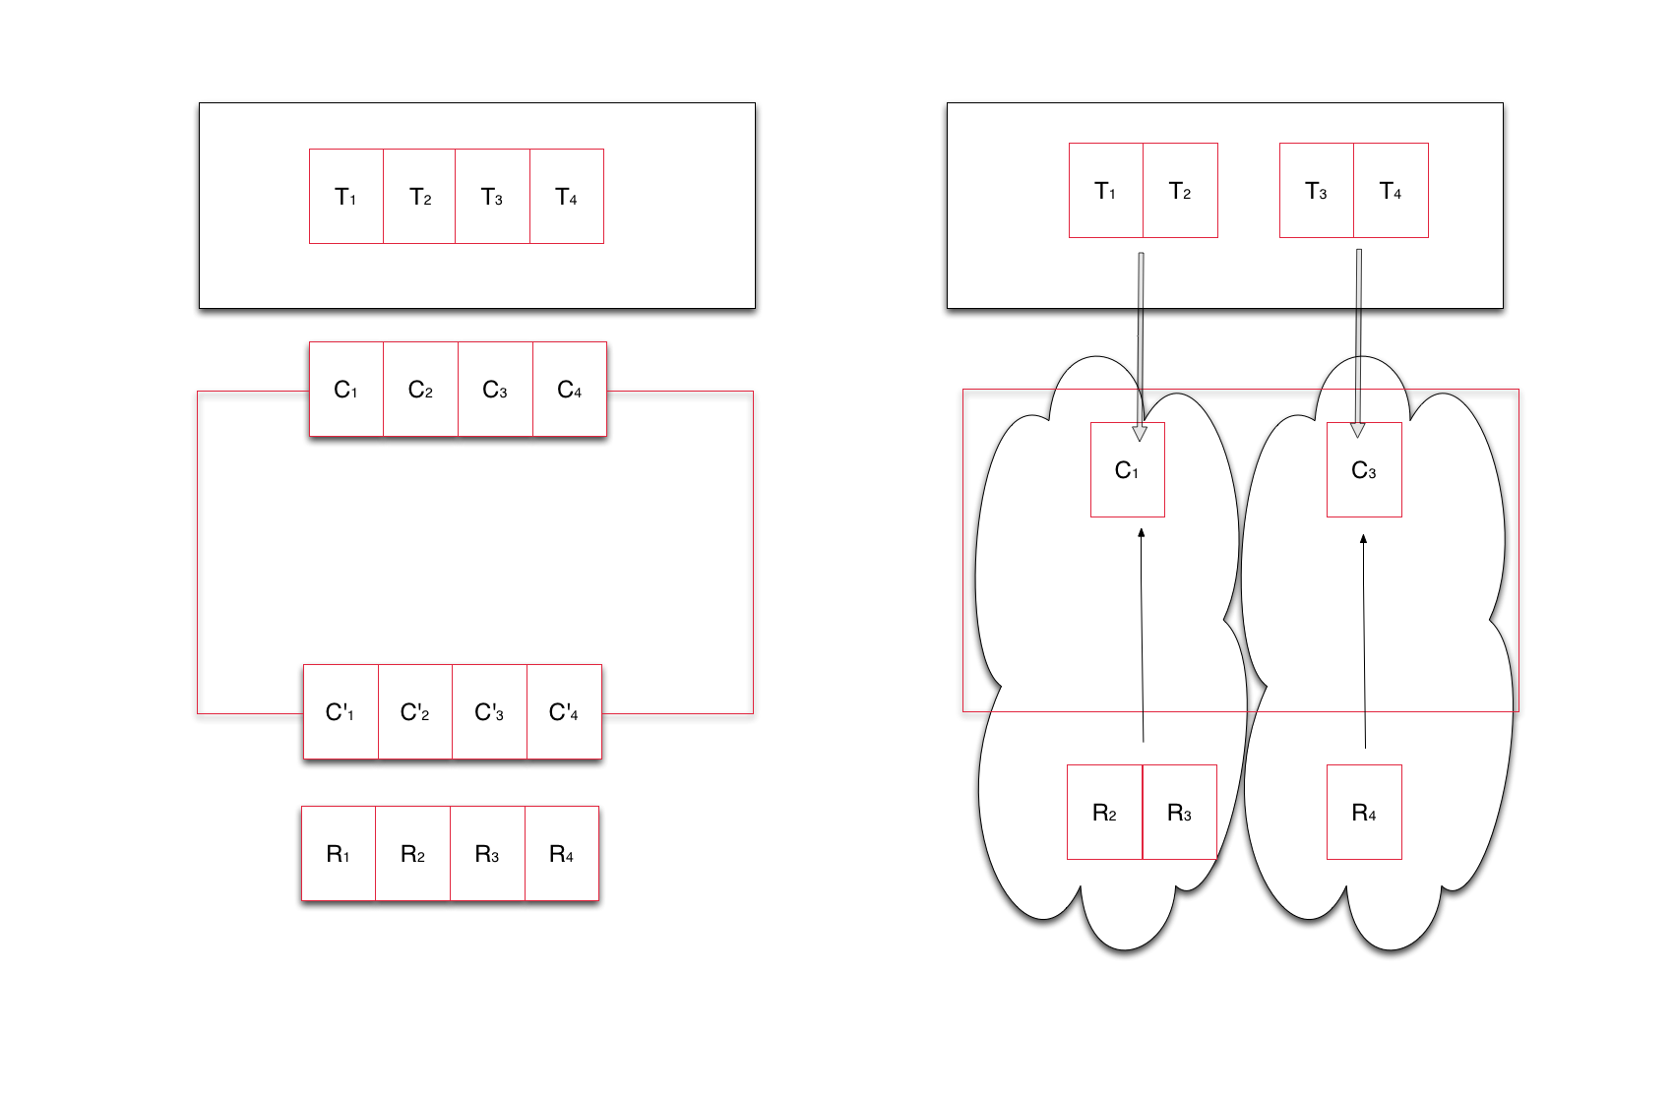
NGMW Schematic
Notes:
Middleware capabilities as an abstraction to resources
Middleware’s responsibility to support the set of capabilities that an application asks for and determine the collection of resources that can/must be used to provide capability

Slide 35
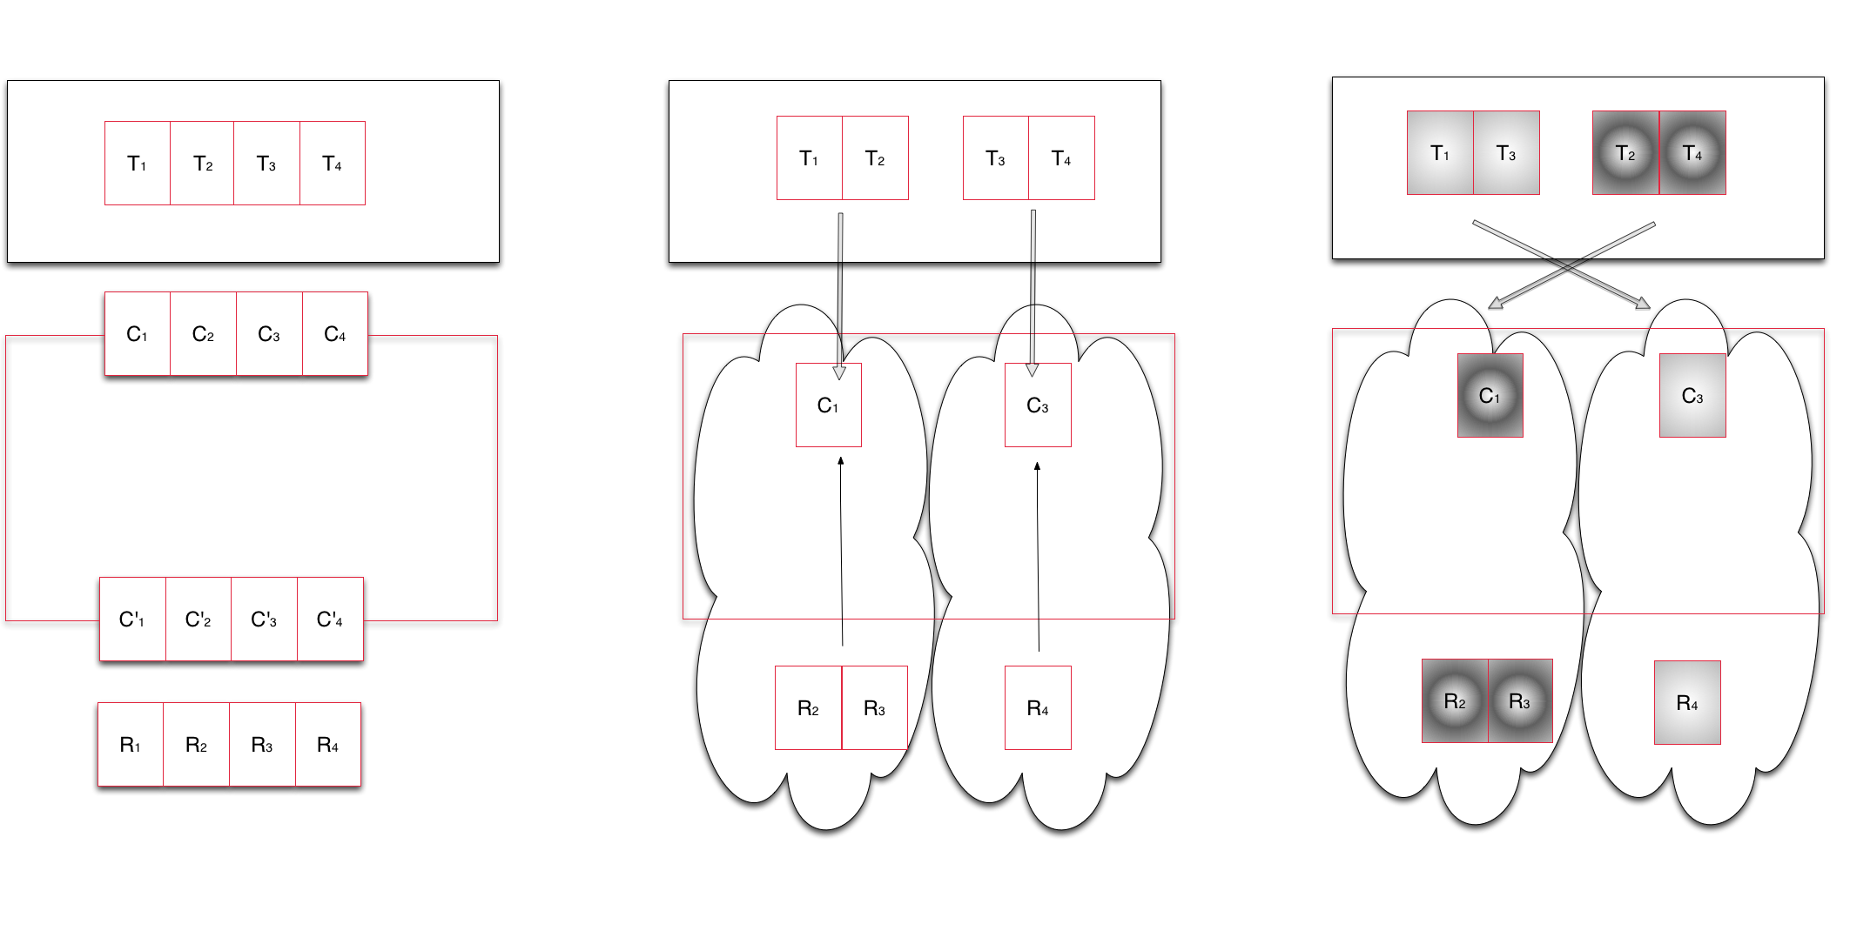
NGMW Schematic
Notes:
Middleware capabilities as an abstraction to resources
Middleware’s responsibility to support the set of capabilities that an application asks for and determine the collection of resources that can/must be used to provide capability

Slide 36
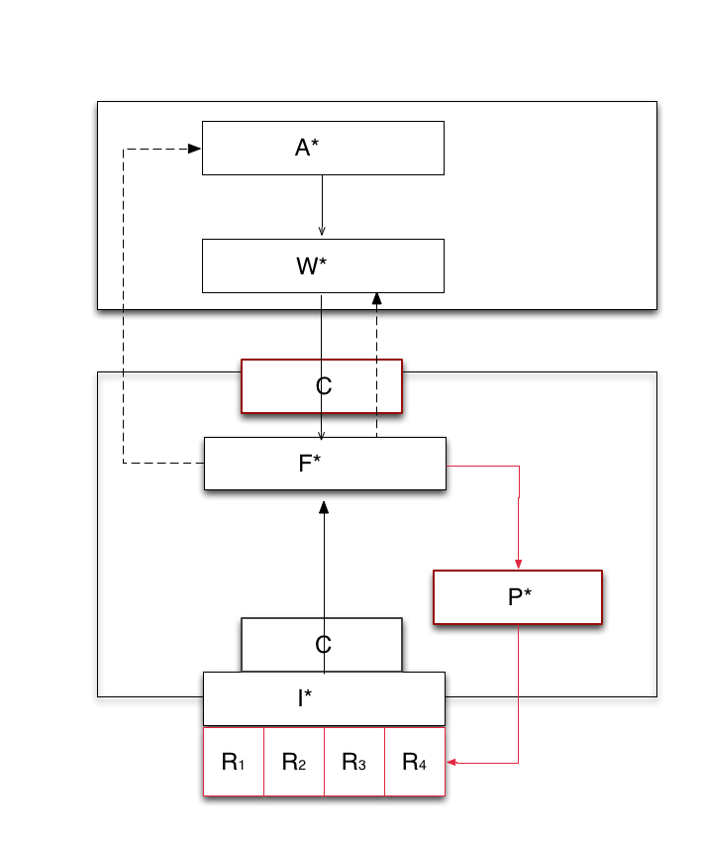
Design Objective: Multi-level Integrated Reasoning
Transformation of application workload via system workload to infrastructure capability
Application requests R(100, T,10), say 100 tasks, of type T, complete within 10 units of time
Federation Layer/Manager responds with collective capability of C(50, T, 10) or C(100, T, 20)
Adaptive Application
Adaptivity can be either at A, W level
Application may self-throttle number of tasks, or type of task generated
Or workload description can be changed to meet the capability
Notes:
We show how *.* meets the first of the design objectives of NGMW at a CONCEPTUAL LEVEL!!

Slide 37
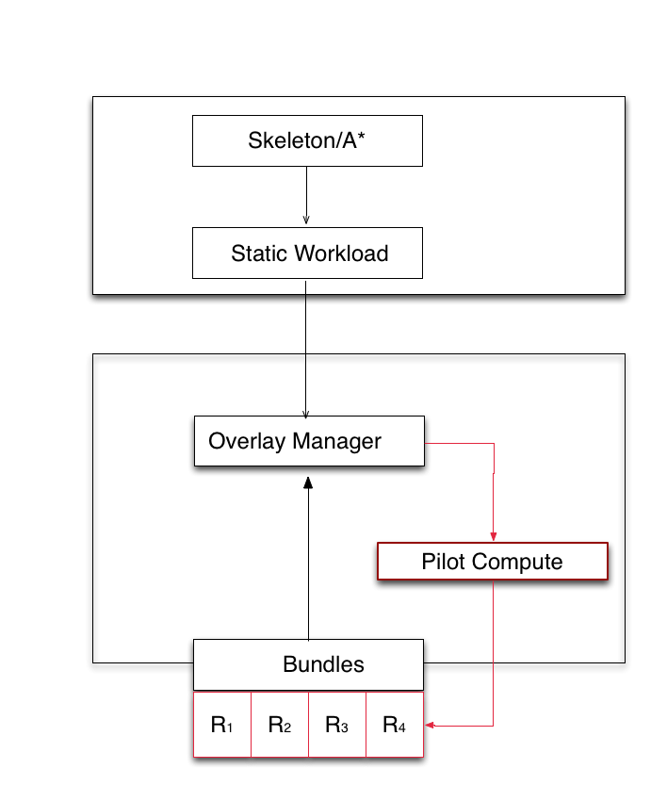
AIMES: Demonstration of Flexible Federation (SC’13)
Application say Bag-of-Tasks
Say BoT(100, H, 10)
Generate similar workload description from different application representations
Bundles currently support federation
Info on resource availability
Eventually resource properties
Ultimately bundles (and I*) should be consistent with C*
Formalize the advantages of dynamic and flexible federation
Performance improvements
Notes:
We take the schematic of NGMW and show how the different levels at which the Models work, (ii) how different models interact, especially (a) Andre and Christian’s work/interface, (ii) I* and F*.

Slide 38
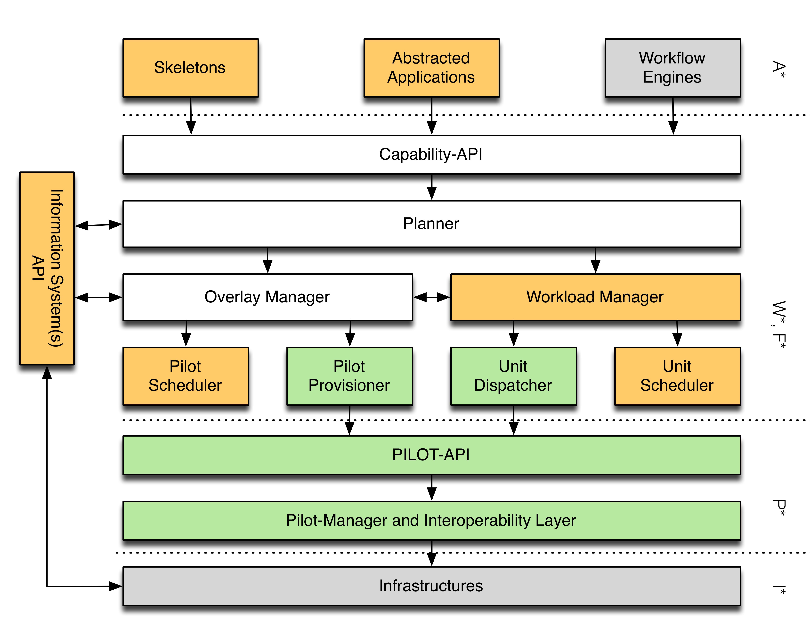
NGMW Architecture for DEC

Slide 39
Conclusion
A fundamental need for abstractions to support many simulations
Requirements: (R1) Support Adaptive Application Formulation, (R2) dynamic resource utilization
Abstractions: (A1) separation of workload and resource management, (A2) Interoperable and Extensible Fashion
Set against these objectives: “Pilot Abstraction Works!”
SAGA-based Pilot Job System: Interoperable execution
Platform independent libraries: different application types, execution modes, coupling schemes
NGMW to address DEC requirements
Functional Aims, Requirements and Design Objectives
Proposed architecture for a capability-based NGMW
Notes:
As often happens reflection/reexamine based upon experience/lessons learned
“Innovation at higher levels”
NGMW: Well defined semantics at each layer.. models

Slide 40
References
SAGA-Python:
http://saga-project.github.io/saga-python/
BigJob: An implementation of P*
http://saga-project.github.io/BigJob/
RADICAL:
http://radical.rutgers.edu/
Publications:
http://radical.rutgers/edu/publications
Tutorials:
https://github.com/saga-project/tutorials/wiki/XSEDE13

Slide 41
Acknowledgements
Graduate Students:
Ashley Zebrowski
Melissa Romanus
Mark Santcroos
Antons Trekalis
Undergraduate Students:
Vishal Shah
Research Scientists:
Andre Luckow
Andre Merzky
Matteo Turilli
Ole Weidner

Slide 42
Acknowledgements/Funding Sources
Active:
NSF CAREER Award 2012 (OCI-1253644)
CDI NSF-CDI (NSF CHE 1125332)
ExTENCI (NSF OCI)
SCIHM NSF-OCI (OCI-1235085)
AIMES DoE-ASCR (DE-FG02-12ER26115)
ExTASY CHE-1265788
Compute Time:
NSF TeraGrid TRAC award TG-MCB090174
NSF FutureGrid Award (No. 42)
Recent Past:
NSF/LEQSF (2007-10)-CyberRII-01
NSF HPCOPS NSF- OCI 0710874 award
UK EPSRC (GR/D0766171/1) and e-Science Institute, UK
NSF OCI 1059635
NIH Grant Number P20RR016456

Slide 43
Challenges: Mapping Tasks to Resources
Optimal Characterization – Finding the optimal workload characterization of an application:
Generality versus specificity.
Class of Applications versus Many application classes/types.
Different applications have different metrics.
Optimal Federation – Finding the optimal resource configurations for a given workload:
Irrespective of whether it is best representation of an application.
Resources availability at extreme scale is variable.
Optimal Mapping – Workload to Resource Mapping:
Static versus Dynamic resource mapping.
Notes:
Our research agenda
We start talking about how the simulations will be map to resources.
Point 1: optimal workload representation and there is no notion of resources.
Point 1.1:
We are not focusing on coming up with an optimal representation of a workload.
We are looking for the common underlying workload characterization.
We focus on generality. We do not focus on a single class of application and tools to support it.
We focus on the long tail of science and, as such, on a broad class of application and general-purpose tools to support them.
Point 1.2:
Applications are not only about what to do but also about the temporal and space boundaries for their execution. These parameters define the metrics for the success of the application run
We need to keep in mind when defining a workload.
Point 2: Find the best set of resources for the given workload. No measure of the goodness of the workload description.
Point 3: Combination of 1 and 2. Worry about both workload and resources and resolve the combined problem of putting both of them together.
Point 3.1:
Kernel = i.e. Matrix Manipulation
Traditionally: HPC map a well-known, stable kernel to a resource pool and repeat. Any differential-equation-based problem (heat diffusion for example)
Workload changes over time, it is dynamic and the kernel may change and, as a consequence, the mapping of the resources to that kernel changes too. E.g. many simulation problem.
In the many simulation time also resources are dynamic and their change in state might trigger a change in mapping.

